Slide 1


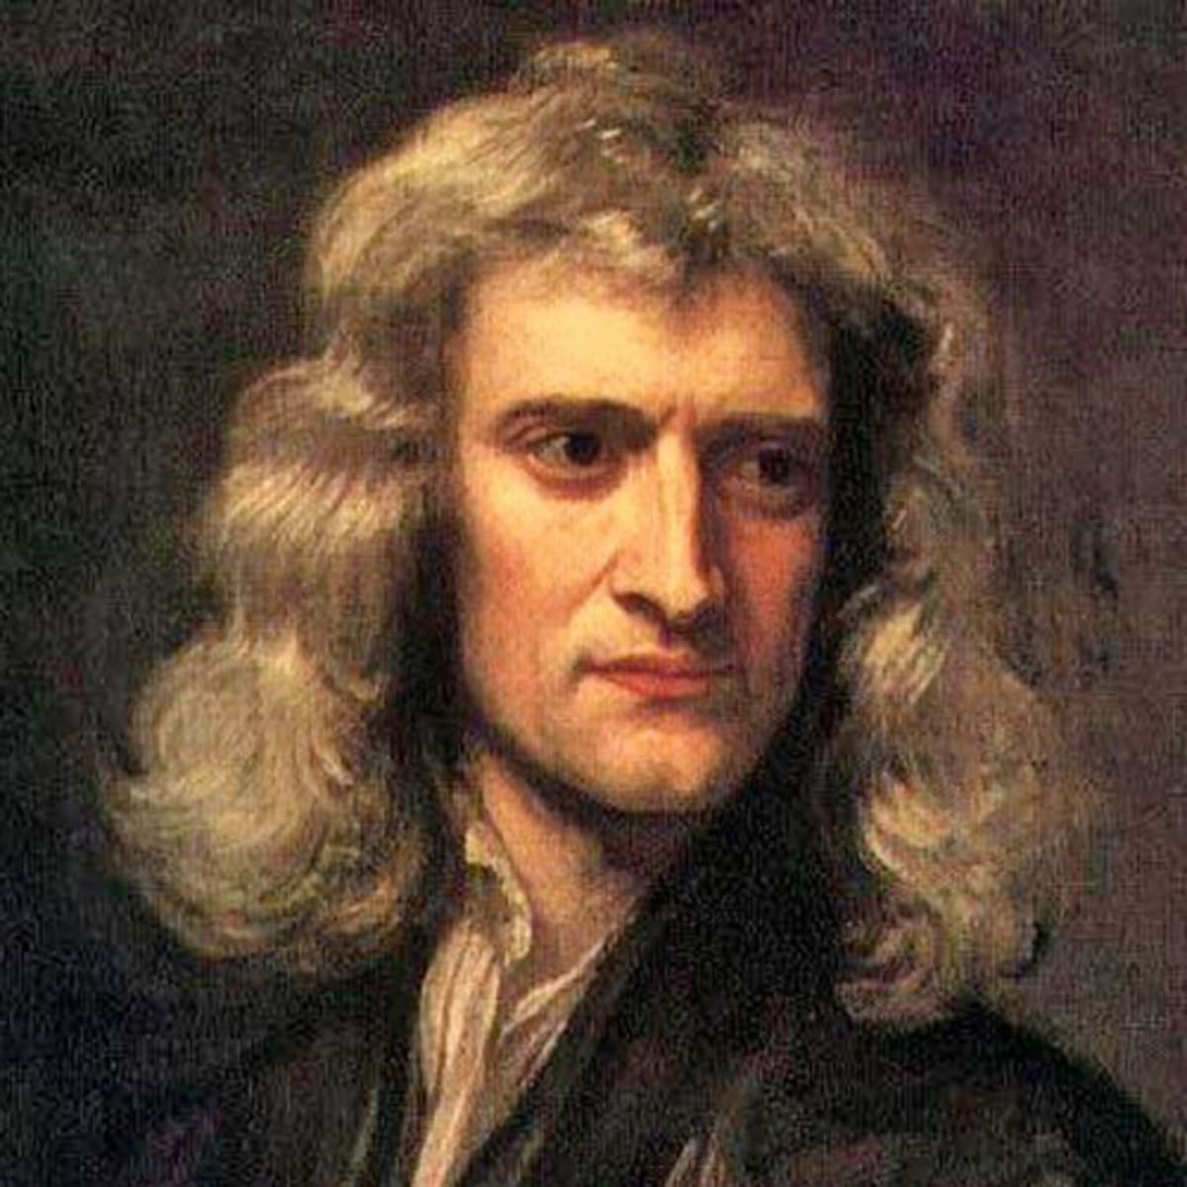
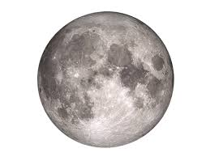
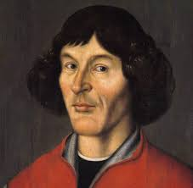
解密神奇的宇宙 Unlocking the secrets of the Universe
Session 3.2: from atoms to strings
The Trouble with Standard Model
Today’s VIP guest list
Standard Model does. Great job in unifying almost all of physical laws in one family of elementary particles: fermions and bosons. However, one obvious shortcoming of the Standard Model theory is that it does not contain gravity – the force of nature we can feel every day!
This gives modern day scientists shivers: could it be that the SM theory is actually not that great after all? Can we save it by introducing auxiliary hypothesis to our model, or do we need to throw the model away and start over with a new paradigm?
There are two key models that scientists hope could reconcile SM with gravity: String Theory and Loop Quantum Gravity. In this session we will meet these theories and ponder their scientific potential to revolutionize science and give us one single Theory of Everything
Isaac Newton
Session objectives
Recap the issues with reconciling General Relativity for big object with Quantum Physics for small objects
Discuss the concept of falsifiability in science
Learn the basic idea behind String Theory and Loop Quantum Gravity
Debate the future of modern physics
Key terms
Quantum gravity
两字引力
Graviton
引力子
Loop quantum gravity
圈量子引力
String theory
弦论
falsifiability
可证伪性
dimensions
纬度

Slide 2

解密神奇的宇宙 Unlocking the Secrets of the Universe
Quantum gravity
量子引力
Any theory that explains gravity in terms of quantum physics. At the moment, there is no quantum gravity that is experimentally confirmed to be “true”.
Graviton
引力子
A boson that is responsible for gravity. We don’t know if it actually exists. We have never “seen” or detected it.
Dark energy
暗能量
Mysterious force that makes the Universe expand!
We don’t know what it is, but we also cannot explain the Universe’s expansion using any known theory
Dark matter
暗物质
Mysterious matter that we cannot “see” or detect because it does not interact with any light. It does have mass, and we know that there is actually more dark matter in the universe than there is “normal” matter (that we are made of). However, we have no idea what dark matter is.
What about gravity…?
You may have noticed that there is one boson missing from the Standard Model table. We have 4 elementary forces with 4 types of interaction bosons attached to them:
Photons – electromagnetic force
Gluons - strong force
W and Z bosons – weak force
….??????? - gravity
When Einstein fails to impress
While excellent at explaining how gravity works (and “what gravity is”) at large scales when we deal with planets, moons, and so on, the General Relativity fails to work at tiny, quantum scales.
Even more disturbing is the fact that we so far have not discovered a ”graviton” – a particle that would conduct gravity in some way to fit into our SM framework.
If we can “only” explain ¾ elementary interactions with Standard Model, does this imply it is wrong?
What could be the missing thing we are not seeing? How could we explain that there seems to not be a “graviton” particle?
Dark energy
Dark energy is the name for the “force” that makes the Universe expand. We don’t know what it is.
Dark matter
Dark matter is matter that is definitely there (we know it has a mass) but that does not interact with any light (hence it is called ”dark”) so we can’t detect it directly, or “see” it. We don’t know what it is.
JinJin STEM Academy

Slide 3
解密神奇的宇宙 Unlocking the Secrets of the Universe
Promising theory 1: String Theory
String theory claims that all elementary particles are all manifestation of a single type of 1-dimensional “string” that vibrates with different frequencies. String Theory is a very complicated mathematical model, but the Standard Model does “pop out” of it, and it contains the graviton, too.
What makes a “good” scientific theory?
What is ”truth”? What does it mean that a scientific theory is “true” or ”false”?
Important term: falsifiability（可证伪性）
In science we often say that a good theory is “falsifiable”: that is, we can prove that it is right or wrong,
1
Recall the scientific revolution cycle from session 1.
When a theory is challenged with new evidence or new, simpler explanation, many times we first come up with an extra “auxiliary” theory to save the original idea from being replaced with a new paradigm. This is what happened when people proposed the complicated orbits of planets to save the “Earth-centric” model of the Solar System with Earth in the middle.
String Theory has been around for a long time but so far it has not been proved right. Whenever experiments show that it is wrong, many scientists still believe that it is likely that we can “save” the theory by coming up with new adjustments to the String Theory (these are auxiliary hypotheses in this case)
So far, all of these attempts have been unsuccessful. The scientific community, however, keeps working on string theory very hard.
Why do you think thousands of very smart physicists around the world keep chasing String Theory despite lack of evidence to prove it is correct?
JinJin STEM Academy

Slide 4
解密神奇的宇宙 Unlocking the Secrets of the Universe
String Theory also makes a bunch of assumptions that are difficult to “imagine” but that work mathematically:
Strings vibrate in at least 9 spatial dimensions (We have never detected more than 3)
There is a whole bunch of “super particles” that exist next to the particles (each particle has its own s-particle friend). (We have never detected these particles)
What does Ockham’s Razor tell us about this case?
Promising theory 1: Loop Quantum Gravity
Loop Quantum Gravity claims that the universe is filled with 2-dimensional “loops” of “quantum size”. The Universe is filled with a “spin network” of these loops that is responsible for what we perceive as gravity, space, and time.
LQG explains not only gravity in quantum terms, but also explains what “happened before Big Bang”
Unfortunately, LQG has not been proved to be right by any observations yet.
1
JinJin STEM Academy

Slide 5
解密神奇的宇宙 Unlocking the Secrets of the Universe
Promising theory 1: String Theory
String theory claims that all elementary particles are all manifestation of a single type of 1-dimensional “string” that vibrates with different frequencies. String Theory is a very complicated mathematical model, but the Standard Model does “pop out” of it, and it contains the graviton, too.
What makes a “good” scientific theory?
What is ”truth”? What does it mean that a scientific theory is “true” or ”false”?
Important term: falsifiability（可证伪性）
In science we often say that a good theory is “falsifiable”: that is, we can prove that it is right or wrong,
1
Recall the scientific revolution cycle from session 1.
When a theory is challenged with new evidence or new, simpler explanation, many times we first come up with an extra “auxiliary” theory to save the original idea from being replaced with a new paradigm. This is what happened when people proposed the complicated orbits of planets to save the “Earth-centric” model of the Solar System with Earth in the middle.
String Theory has been around for a long time but so far it has not been proved right. Whenever experiments show that it is wrong, many scientists still believe that it is likely that we can “save” the theory by coming up with new adjustments to the String Theory (these are auxiliary hypotheses in this case)
So far, all of these attempts have been unsuccessful. The scientific community, however, keeps working on string theory very hard.
Why do you think thousands of very smart physicists around the world keep chasing String Theory despite lack of evidence to prove it is correct?
JinJin STEM Academy

Slide 6
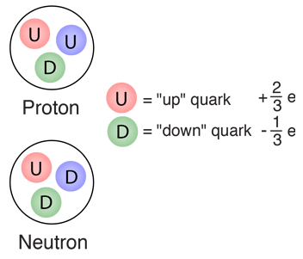
解密神奇的宇宙 Unlocking the Secrets of the Universe
Quarks make up hadrons – you already know hadrons!
1
http://hyperphysics.phy-astr.gsu.edu/hbase/Particles/quark.html
Leptons are really, really small
Electrons: we all know and love them. They are useful particles.
Neutrinos are almost massless, hardly ever interact with anything, and don’t really do anything.
However, observing neutrinos can tell us a lot about the events that created them, such as supernova explosions, black holes, etc.
All fermions also have anti-fermions (anti-particles)
Anti-particles are known as anti-matter
If anti-matter meets matter, they usually collide and annihilate (destroy) each other, emitting energy as photons.
JinJin STEM Academy

Slide 7
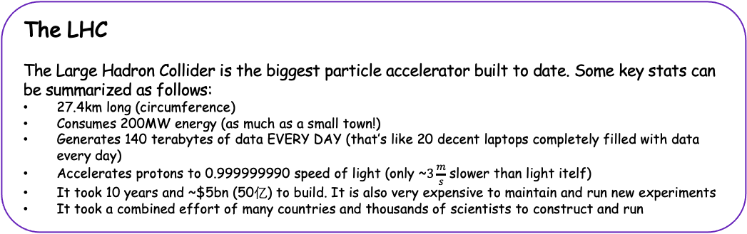
解密神奇的宇宙 Unlocking the Secrets of the Universe
Hadron colliders (particle accelerators)
In order to detect more and more particles, we often smash particles together and see what happens.
Machines used for smashing particles are called particle accelerators, or hadron colliders (because they smash hadrons together)
In some experiments we smash together leptons, so the machines used for the smashing should be called “lepton colliders”. Particle accelerator is a general name for any machine accelerating any kind of particle. If we smash together hadrons (usually protons), then the machine is indeed a “hadron collider”
How can we accelerate protons in a particle accelerator?
Linear Colliders
The structure of a linear collider is simple: it’s just a long tube in which particles are accelerated before hitting a specific target.
Linear Colliders are used not only in physics research, but also in hospitals for generating particle streams used in radiotherapy (cancer treatment)
Circular Colliders
Circular colliders accelerate the particles and at the same time bend their trajectory (path) so that the particles always remain on a fixed circular path.
The largest circular collider built to date is located in Switzerland
The LHC
The Large Hadron Collider is the biggest particle accelerator built to date. Some key stats can be summarized as follows:
27.4km long (circumference)
Consumes 200MW energy (as much as a small town!)
Generates 140 terabytes of data EVERY DAY (that’s like 20 decent laptops completely filled with data every day)
Accelerates protons to 0.999999990 speed of light (only ~$3\frac{m}{s}$ slower than light itelf)
It took 10 years and ~$5bn (50亿) to build. It is also very expensive to maintain and run new experiments
It took a combined effort of many countries and thousands of scientists to construct and run
JinJin STEM Academy

Slide 8
解密神奇的宇宙 Unlocking the Secrets of the Universe
How are particles accelerated?
Why do we construct circular particle accelerators?
👉 Electric field accelerates particles
👉 Magnetic field keeps particles on a circular orbit
Are particle accelerators “useful”?
Why do humans spend so much money, time and effort on discovering and exploring the basic principles of the Universe?
Cancer treatment technologies, such as PET scans, are a product of Particle Physics
Touchscreens were first developed at CERN (home of the LHC)
The Internet (WWW) was created by particle physicists to communicate with their colleagues across the globe
Accelerators are used in certain industrial processes as well
JinJin STEM Academy

Slide 9
解密神奇的宇宙 Unlocking the Secrets of the Universe
Session Summary
Elementary Particles are the tiniest building blocks of matter (fermions) + the messenger particles that tell them how to interact with one another (bosons)
The model describing this system of particles is called the Standard Model of Particle Physics.
We can detect and study elementary particles by smashing them against one another in particle accelerators such as the Large Hadron Collider
Ponder before next class
Discovering new particles can tell us about what things are made of, and explain a lot about e.g. how the Universe was created. But do you think such investment is “worth the money” bearing in mind how expensive it is to construct the large particle accelerators?
The Standard Model explains almost everything about the universe’s basic mechanisms. Do you think it is close to being the “ultimate theory” or everything?
Is the Standard Model “simple”?
JinJin STEM Academy

